Slide 1
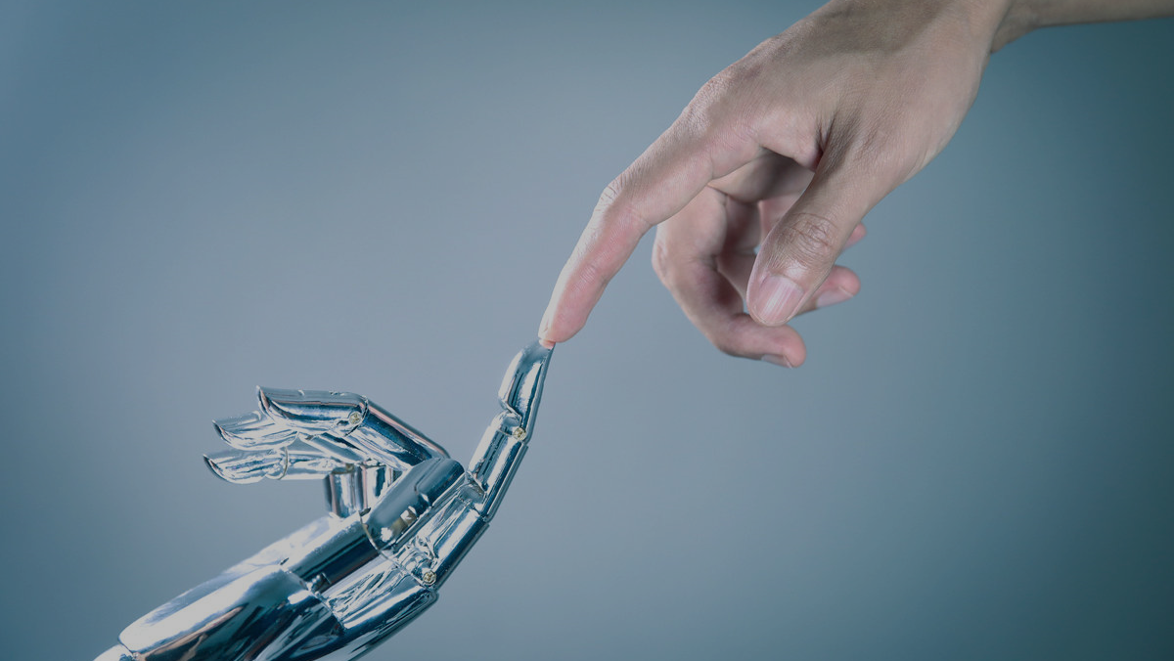
Artificial Intelligence
Ashot Matevosyan

Slide 2
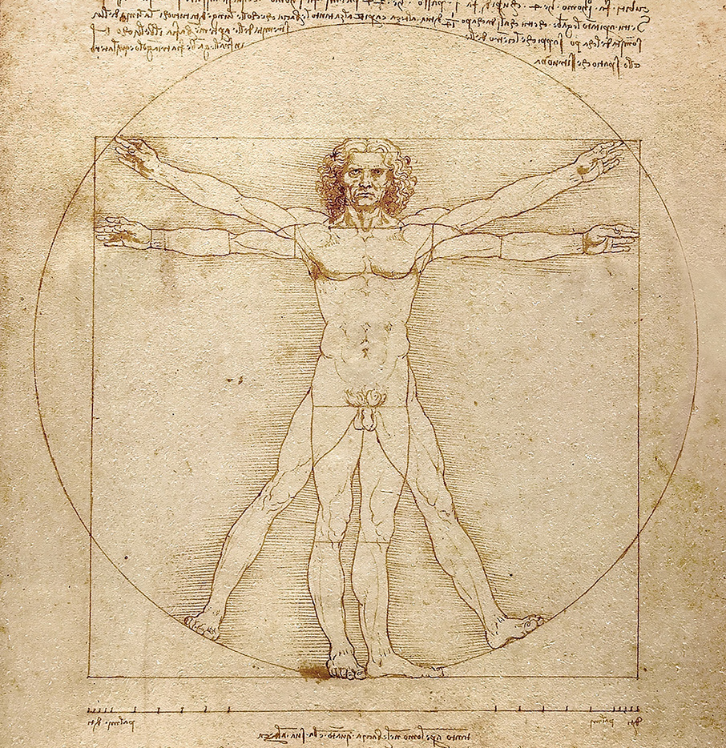
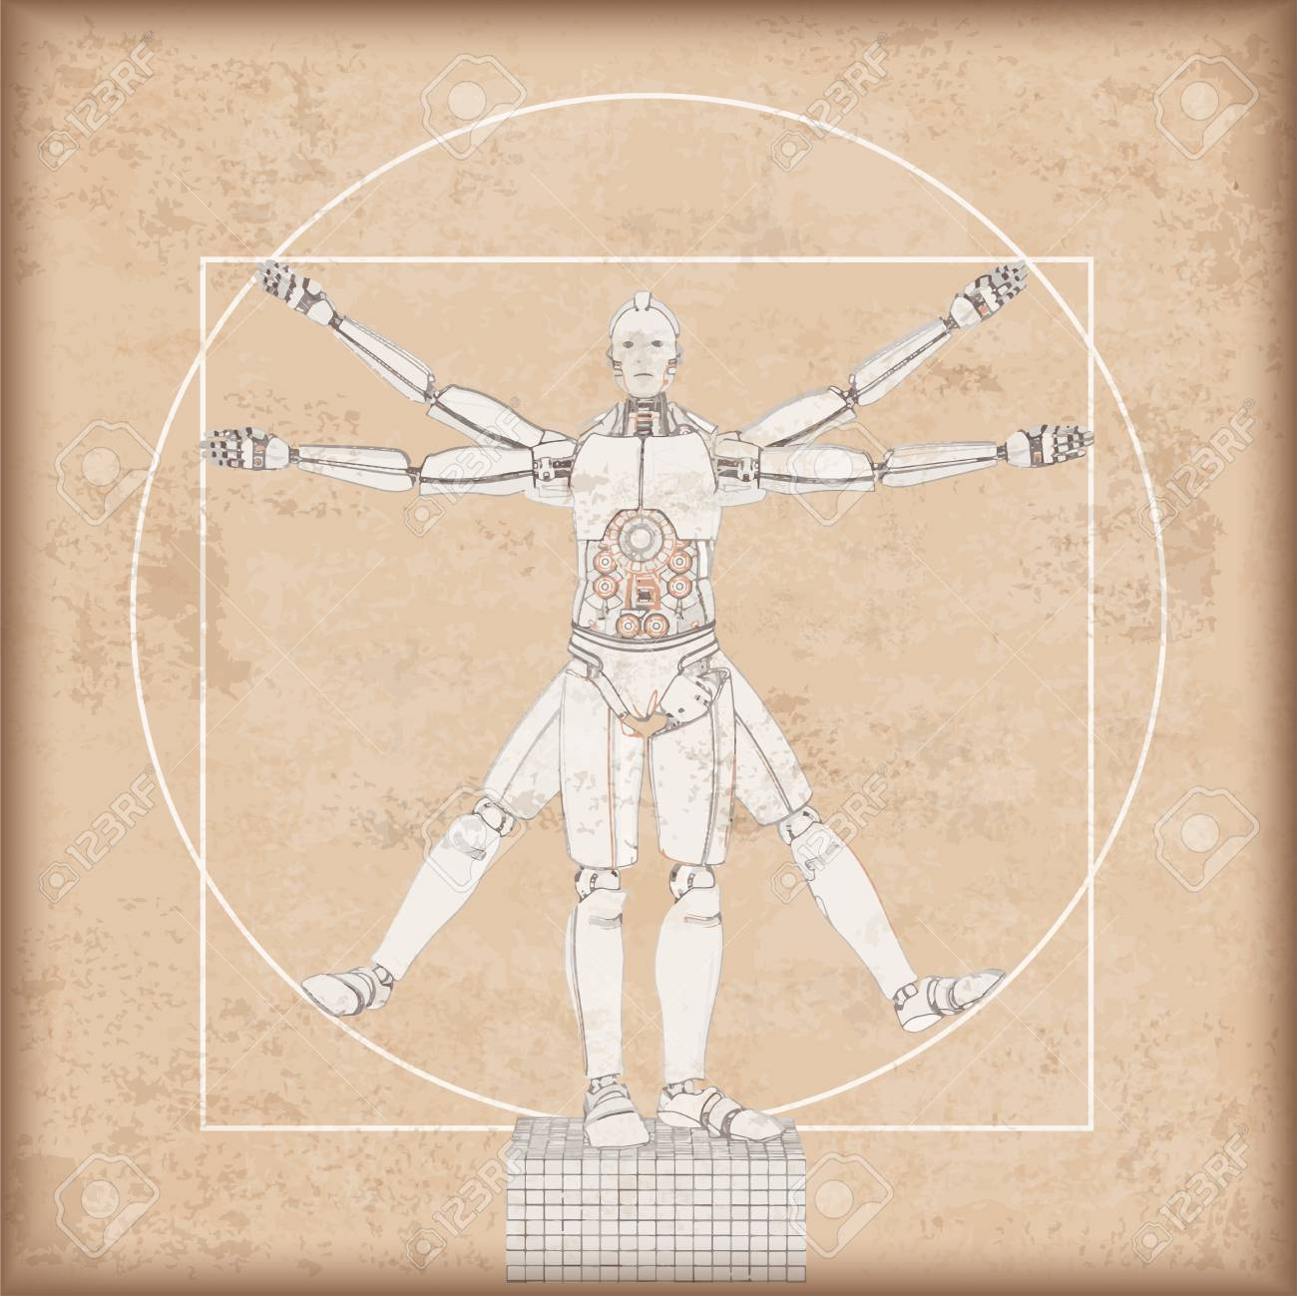

Slide 3
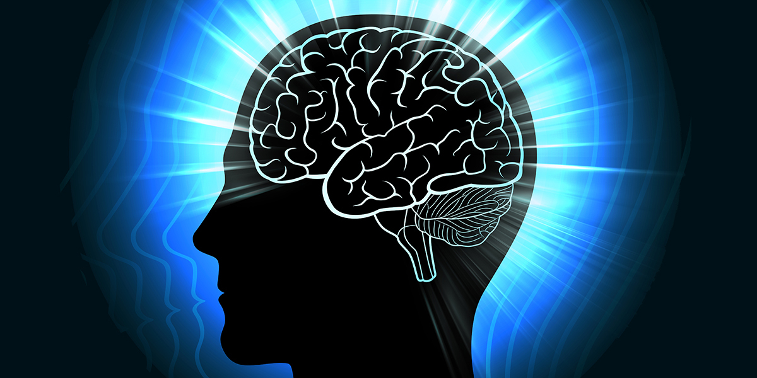
Modeling Human Brain

Slide 4
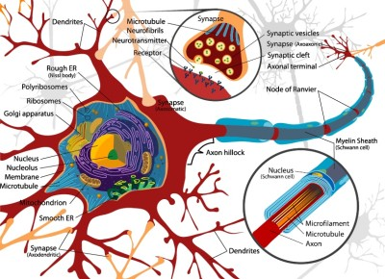
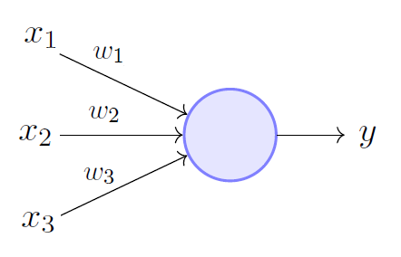
Neural cell
Neuron
Artificial neuron

Slide 5
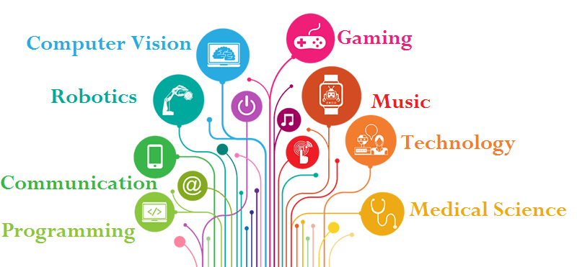

Slide 6
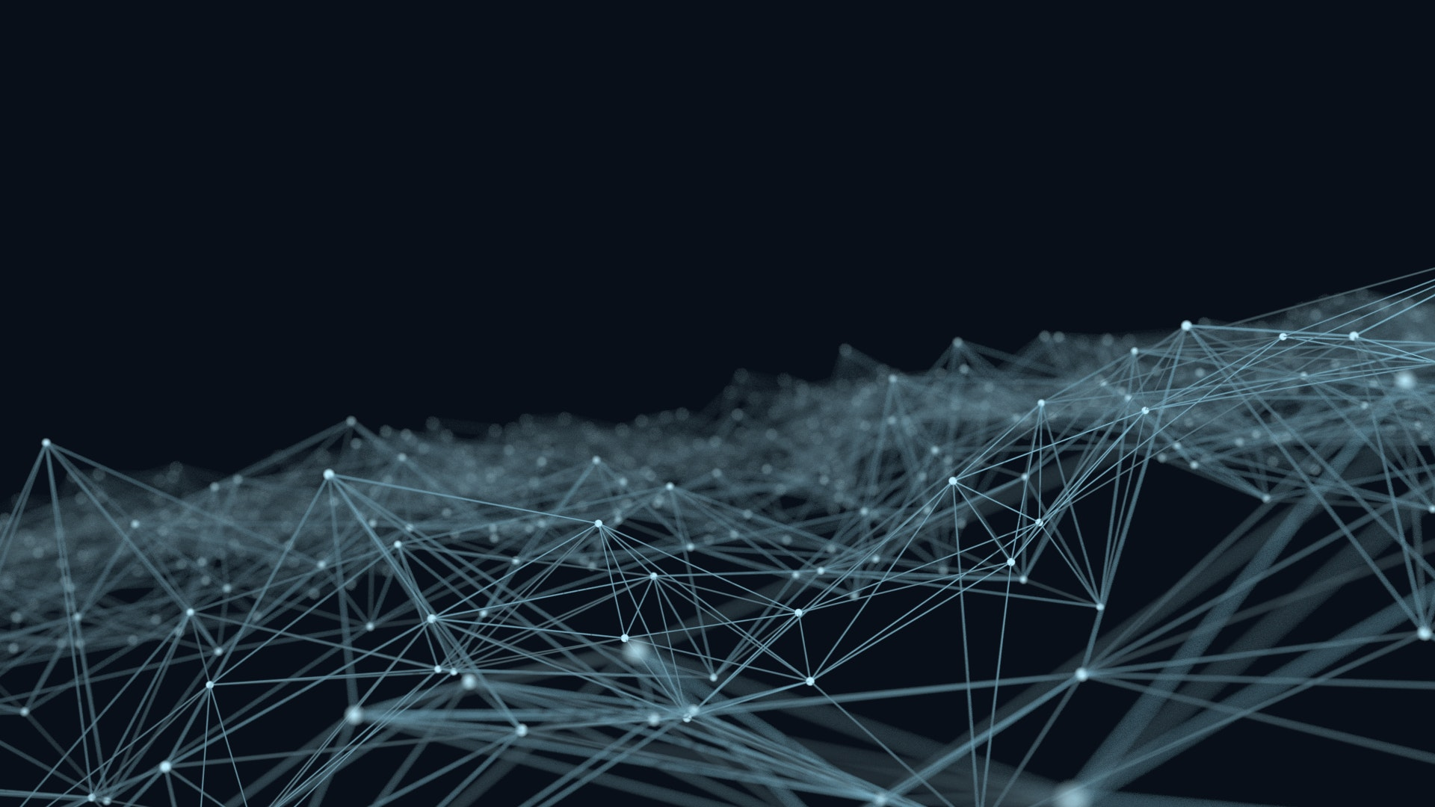
Back to reality…
Artificial Intelligence
Machine Learning

Slide 7
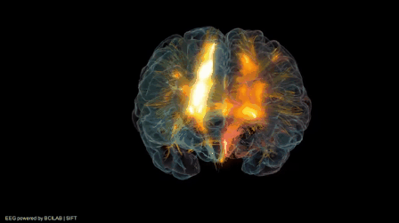
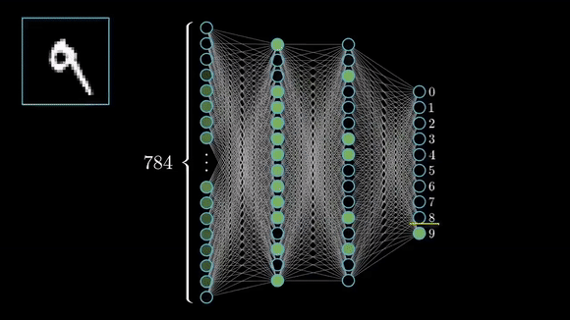


Slide 8
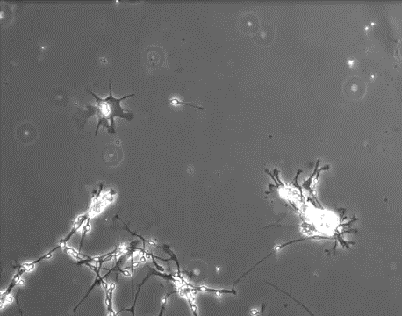

Slide 9
Note the difference
Artificial Intelligence
Machine Learning
Deep Learning

Slide 10
Our Course

Slide 11

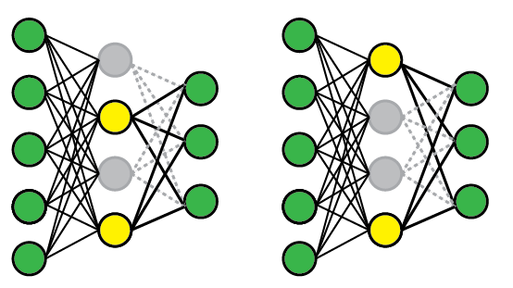
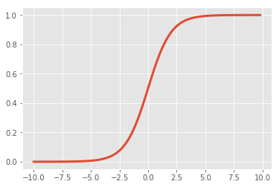
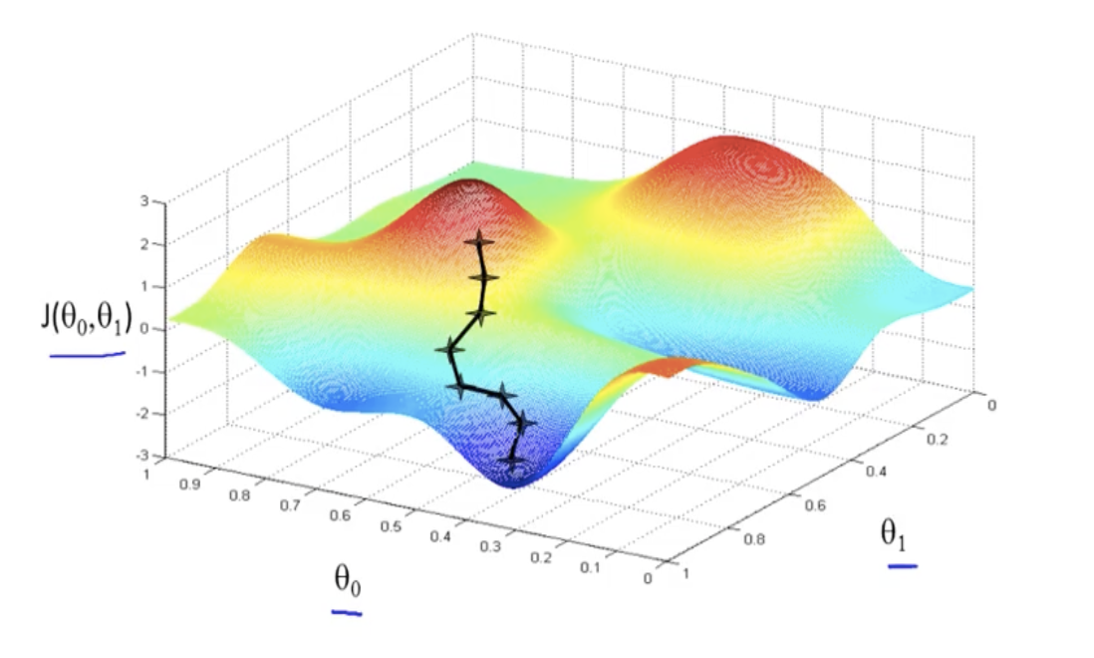
Our Course
Own deep learning platform
Fully connected layer
Activation functions
Loss functions
Optimization algorithms
Regularization methods
Backpropagation
…

Slide 12

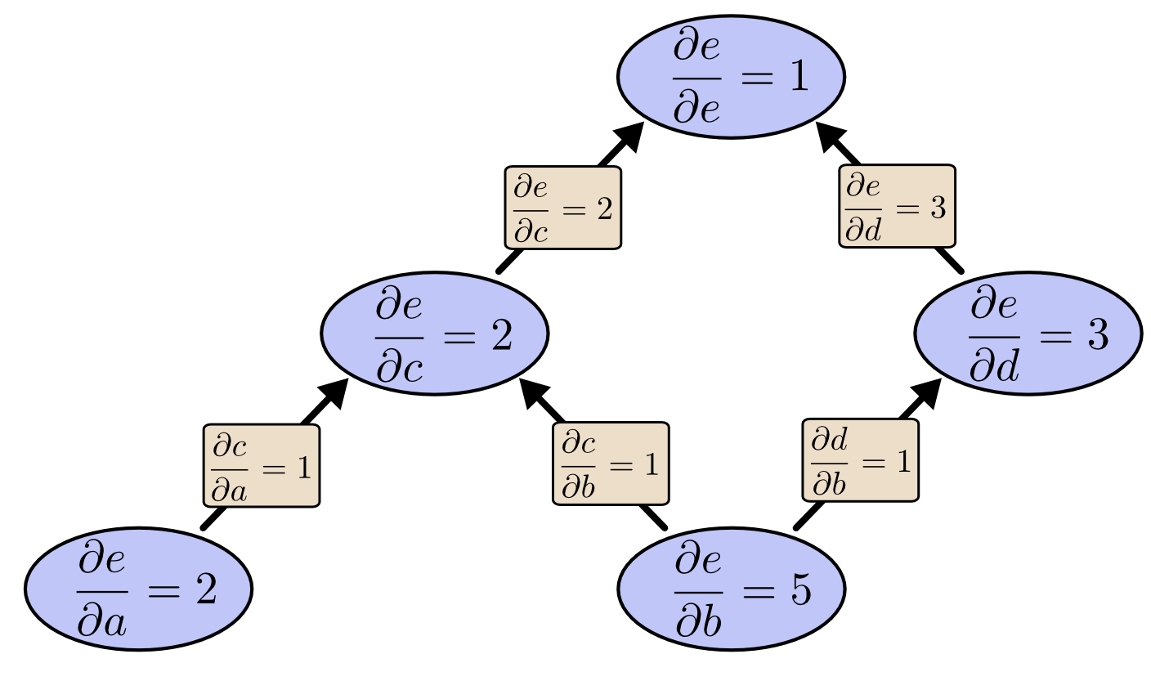

Our Course
Own deep learning platform
Symbolic programming
Backpropagation, architecture…

Slide 13


Our Course
Own deep learning platform
Symbolic programming
Image classification
Backpropagation, architecture…
Such as TensorFlow
Convolutional networks
Dog or cat?

Slide 14

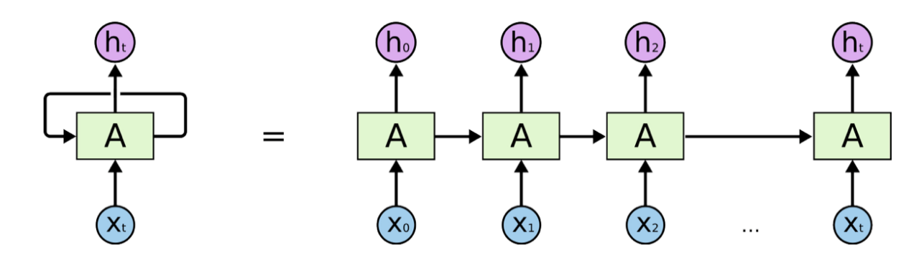
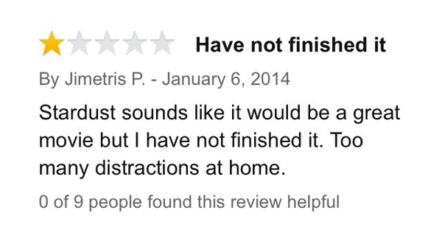
Our Course
Own deep learning platform
Symbolic programming
Image classification
Sentiment analysis on movie reviews
Backpropagation, architecture…
Such as TensorFlow
Convolutional networks
Recurrent networks

Slide 15
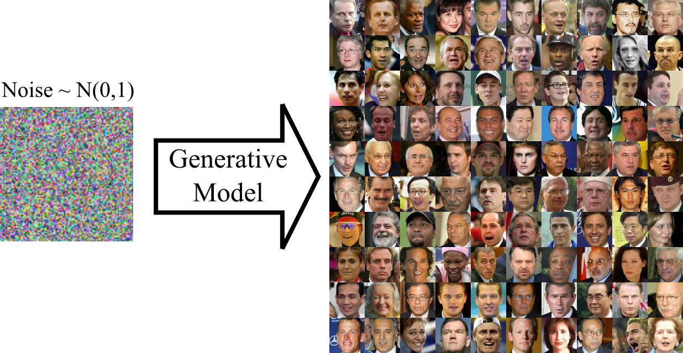
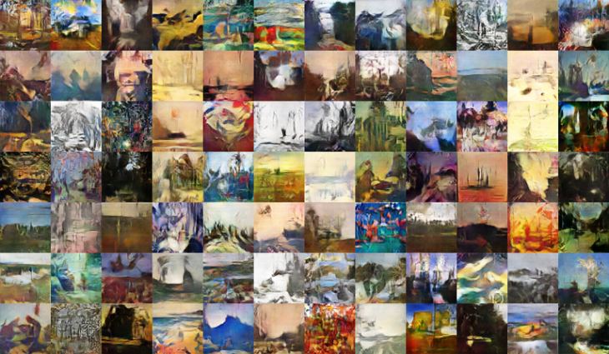
Our Course
Own deep learning platform
Symbolic programming
Image classification
Sentiment analysis on movie reviews
Generative models
Backpropagation, architecture…
Such as TensorFlow
Convolutional networks
Recurrent networks
GANs, AutoEncoders

Slide 16
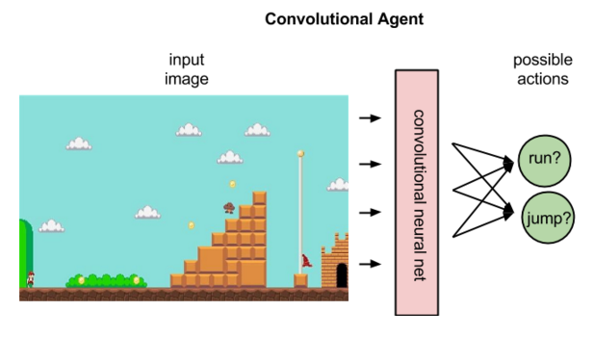
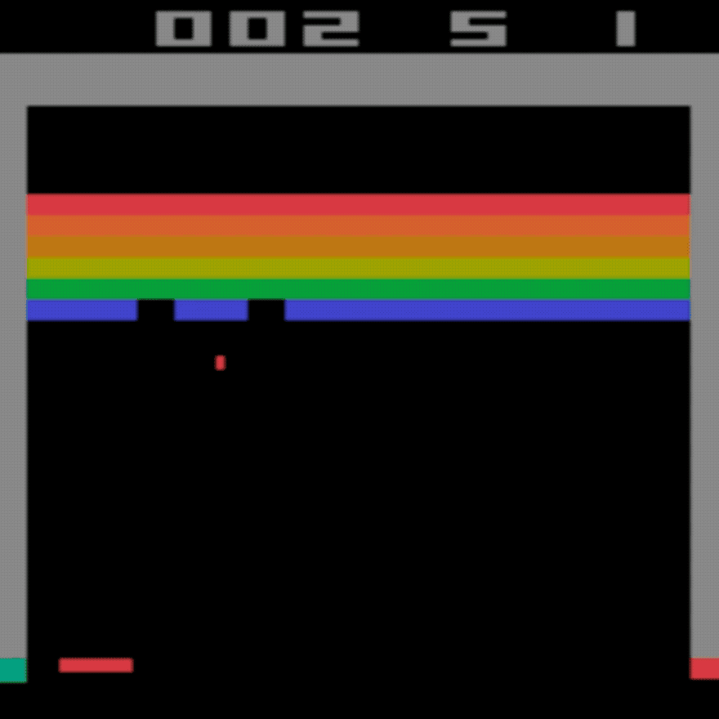
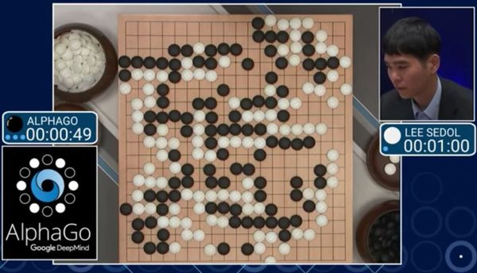
Our Course
Own deep learning platform
Symbolic programming
Image classification
Sentiment analysis on movie reviews
Generative models
Reinforcement learning
Backpropagation, architecture…
Such as TensorFlow
Convolutional networks
Recurrent networks
GANs, AutoEncoders
Q-learning, deep Q-learning

Slide 17
Question asking protocol
!

Slide 18
Questions so far?
?

